Slide 1
Structure de la présentation
Title, name, supervisors name, semester project, ECTs credits, faculty (microtechnique)
Motivation
Vidéo ou snapshot 3D pour expliquer l’intérêt du projet (certains scan trop lent)
GT + Overlap des mesures (montrer la position des mesures) (bien indiquer les axes)
Poser le problème d’interpolation (f(x,t) = sum c b b etc.), v = Hc -> instable numériquement -> iterative method
-> permet d’utiliser des régularisations R(c), GlobalBioIm, to begin the project with b1
Results of b1: GT, naive, lambda=0, lambda = tmp
Results of b3: GT, naive, lambda=0, lambda = tmp Comparison b1,b3 : GT, b1, b3, b1 - b3 (diff map)
Future directions:
Extension to 2D, 3D + time
Add noise to measurements and assess regularisations effects (Denoising)
Application to real data
Recover the whole function f(x,t) (show example of Gaussian) (orally tell if time permits)

Slide 2
Timing correction for slow-scanning biomedical imaging devices
Semester project: 10 ECTS
Luca Fetz, faculty of microtechnique
Supervisors : Thomas Debarre, Thanh-an PHAM

Slide 3

Motivation

Slide 4
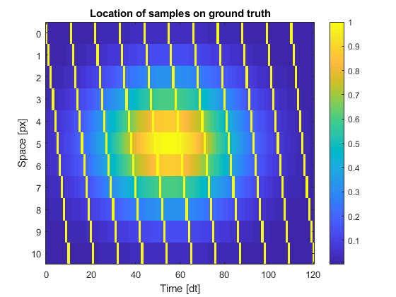
Project goals
Model sampling correctly.
Add timing correction to frames
First step in 1D + time

Slide 5

Usual approximation

Slide 6
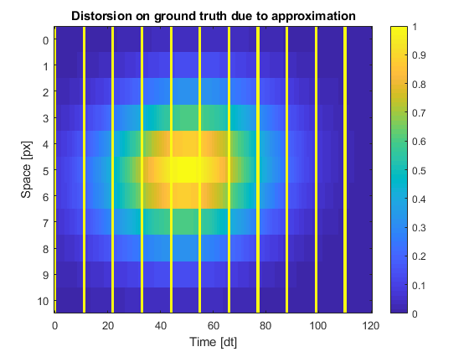
Usual approximation

Slide 7
Comparison project goal and usual approximation

Slide 8
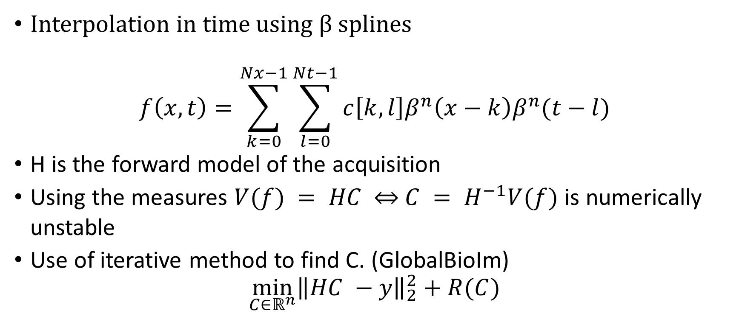
Mathematical model
Interpolation in time using $β$ splines
$$f\left(x,t\right)=\sum_{k=0}^{Nx−1}{\sum_{l=0}^{Nt−1}{c\left[k,l\right]β^{n}\left(x−k\right)β^{n}(t−l)}}$$
H is the forward model of the acquisition
Using the measures $V(f) = HC$ $\overset{⇔}{ } C = H^{−1}V(f)$is numerically unstable
Use of iterative method to find C. (GlobalBioIm)
$$\min_{C∈ℝ^{n}}{{\left\|HC −y\right\|}_{2}^{2}+R(C)}$$

Slide 9
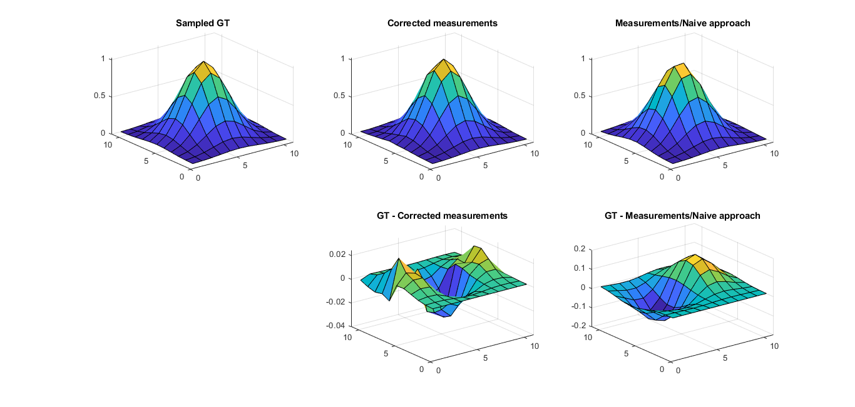
First results: spline order 1

Slide 10
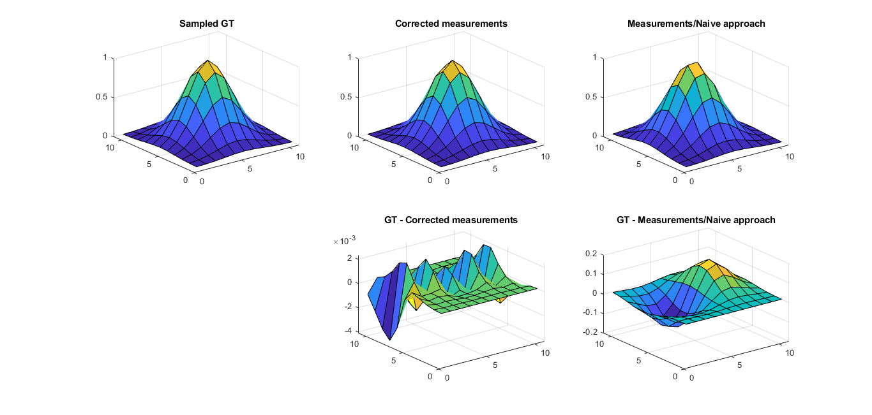
First results: spline order 3

Slide 11
Future directions
Extension to 2D, 3D + time
Add noise to measurements and assess regularisations effects (Denoising)
Application to real data
Recover the whole function f(x,t) (show example of Gaussian)

